Slide 1
EMBEDDED SYSYEM DEVELOPMENT L.U 2: DEVELOP HARDWARE DEVICE

Slide 2
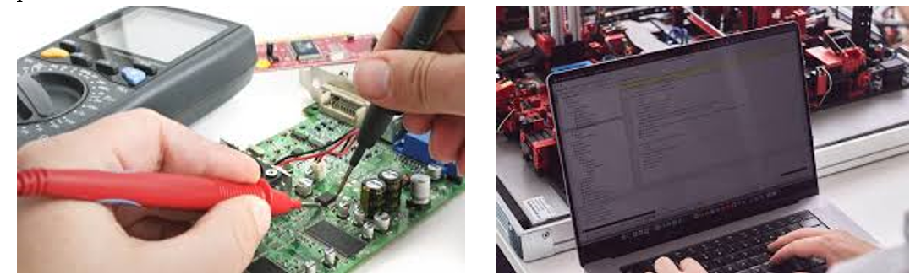
Analyze this image and tell us what you observe?

Slide 3
Developing a hardware device involves several steps, including :
Conceptualization (the process of creating a concept or idea in a broad mindset),
Design,
Prototyping,
Testing, and manufacturing.
The process requires technical skills and knowledge in areas such as electronics, mechanics, and programming.
It also involves understanding market needs and consumer behavior to create a device that meets their needs.
Additionally, the development process requires collaboration between engineers, designers, and manufacturer to ensure the product is scalable, reliable, and cost-effective.

Slide 4
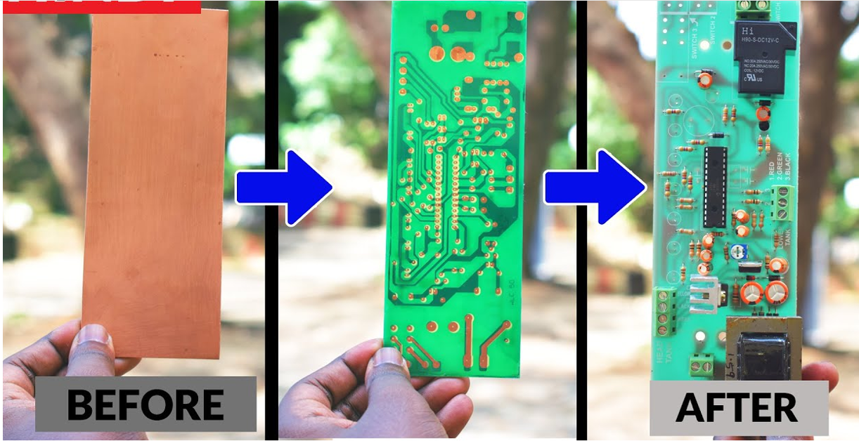
2.1.Production of Printed Circuit Board (PCB)
Analyze this image and tell us what you observe?

Slide 5
A printed circuit board (PCB), also called printed wiring board (PWB), is a medium used to connect or "wire" components to one another in a circuit.
A printed circuit board (PCB) is a flat electronic board that is used in various types of electronic devices.
The PCB is made using a process called photolithography, where a mask is used to expose a photosensitive film on the board to light.
The exposed film is then developed and treated with a chemical that creates a small wire-like connection on the surface of the board.
PCBs can be single-layer or multi-layer and are available in various sizes and shapes.
The production of PCBs can involve manual or automated processes, depending on the complexity of the design and quantity of boards required.

Slide 6
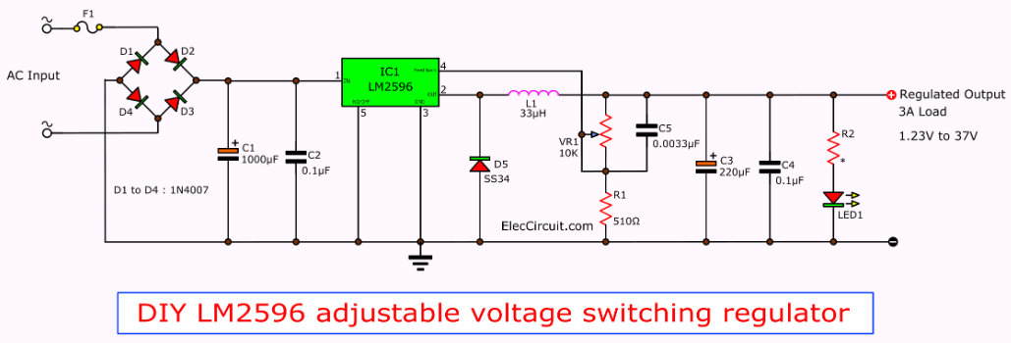
2.1.1.Import designed circuit diagram
Analyze this image and tell us what you observe?

Slide 7
Designing a circuit requires both knowledge and software skills.
By allowing the import of a circuit diagram, one can bring from their existing design to the software a blueprint of the circuit to be created.
This can reduce the initial design time, improve accuracy and precision, and allow for circuit modification without having to start from scratch.

Slide 8
2.1.2.Component Placement
Component placement is an electronics manufacturing process that places electrical components precisely on printed circuit boards (PCBs) to create electrical interconnections between functional components and the interconnecting circuitry in the PCBs .
Component placement is a critical part of electronic circuit design, requiring careful consideration of several factors such as :
Component orientation,
Signal paths, and
Board size and layout

Slide 9
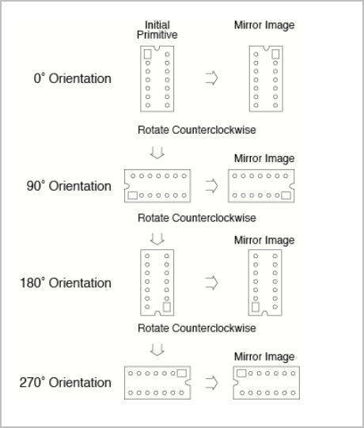
1.Component orientation
The orientation of a component can affect its electrical performance and how it interacts with other components on the board.

Slide 10
2.Signal paths
A signal paths are a path that a signal takes from its origin through multiple components and nets to its destination.
Signal paths refer to the path that an electrical signal takes through a circuit, and proper signal routing can minimize signal interference and improve signal quality.

Slide 11
3.The size of the board and its layout
Board size refers to the physical size of a printed circuit board, while layout refers to the arrangement of components on the board.
In component placement, board size and layout play important roles in determining the appropriate size of the board for a particular application, ensuring that all components fit comfortably and function properly.
Generally, larger boards provide more space for components and wiring, allowing for greater flexibility in layout, while smaller boards are more compact and suitable for smaller projects.
It's important to choose a board size and layout that accurately reflects the requirements of the project to ensure a successful outcome.

Slide 12
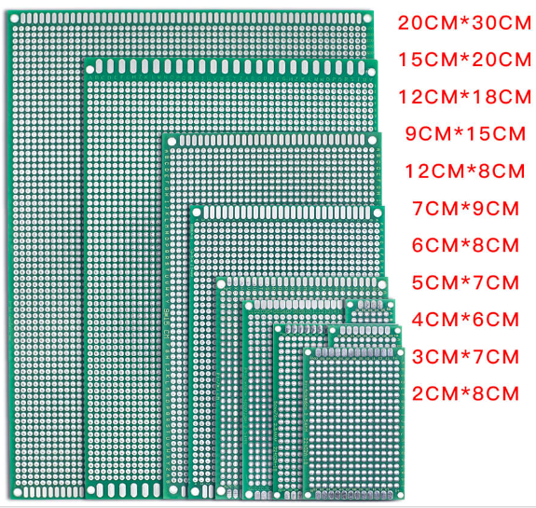

Slide 13
2.1.3. Routing
Routing in PCB production refers to the process of connecting the electronic components on a printed circuit board (PCB).
It involves creating a layout that connects the components to a common power supply and communicates with each other so that they can perform their intended functions.
It is classified into two:
Automatic routing
Manual routing

Slide 14
1.AUTOMATIC ROUTING
Automatic routing in PCB production refers to the use of computer-aided design (CAD) software to automatically generate a routing plan for a printed circuit board (PCB) design.
This process involves placing components on the PCB and then connecting them electrically by creating a routing plan that specifies the path for each electrical connection.
Automatic routing can save time and reduce errors in PCB production by allowing designers to easily modify and adjust the routing scheme as needed.

Slide 15
2. MANUAL ROUTING
Manual routing in PCB production involves using a manual tool for routing traces, pads(plugs), and class sections in a PCB.
The process does not rely on computer algorithms or automated systems, but instead requires the operator to manually adjust the layout of the components and wires to fit on the space available on the PCB.
Because it requires the input of design concepts and manual adjustments, manual routing can be a time-consuming process, and results can be less precise than with automated systems.
However, manual routing can be useful in situations where automation is not feasible, or for in small-scale prototyping .

Slide 16
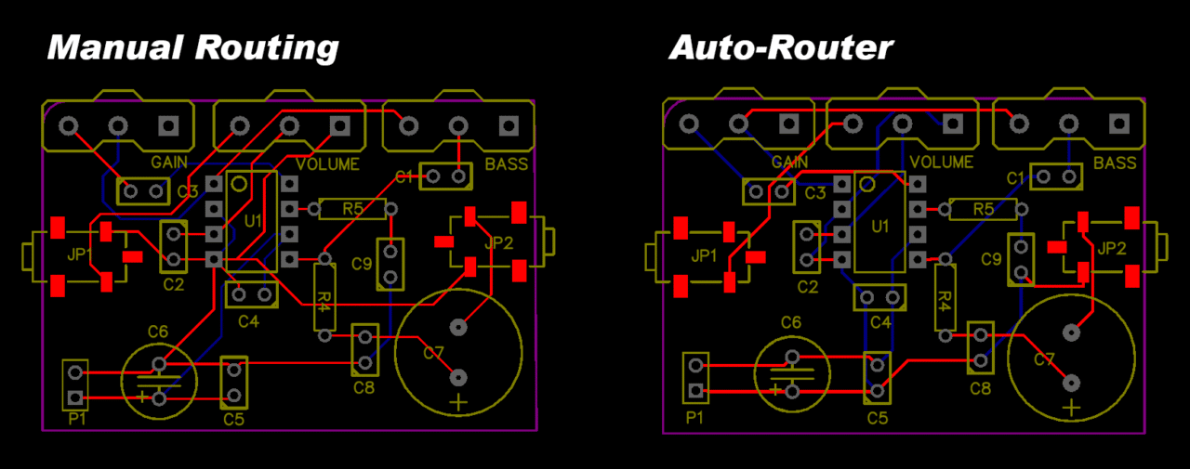

Slide 18
2.1.4. Ground and Power distribution
Both Ground and power distribution in PCB refer to the practices and components used to ensure the safe and efficient distribution of power and ground signals in a printed circuit board (PCB).
Power distribution involves routing power from the power source to the different components on the PCB while ground distribution involves routing the ground signal to provide a reference point for the circuit.
This helps to minimize noise and interference, improve signal integrity, and ensure the safe operation of the circuit.

Slide 19
Common components used in power and ground distribution in PCBs include :
Power planes,
Voltage regulators, and
Ground planes.
Power and ground planes are large areas of copper that are used to distribute power and ground throughout the board.

Slide 20
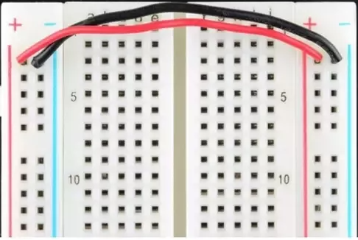

Slide 21
2.1.5. Gerber File Generation
Gerber files are a set of files used in the manufacturing of printed circuit boards (PCBs). When creating a PCB, engineers design the circuitry using software that generates various files, including Gerber files.
These files contain information about different layers of the PCB, such as copper traces, solder mask, and drill holes.
The Gerber files serve as a standardized format that PCB manufacturers use to understand the specifics of the design, allowing them to produce the PCB accurately according to the designer's specifications.
These files typically contain information about the circuit layout, component placement, and routing, and are used to generate a physical layout of the circuit on a printed circuit board

Slide 22
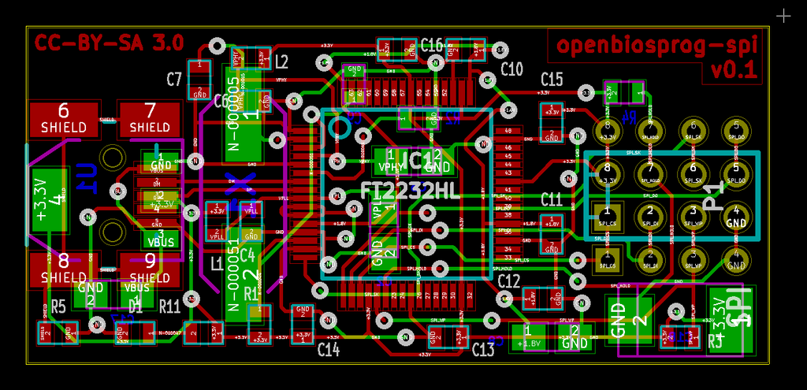

Slide 23
2.1.6. Printing the PCB
PCB, or printed circuit board, is a flat, electronic board designed to carry components and connect them together using conductive traces.
To print a PCB design, a printer that specializes in PCBs, such as an inkjet or laser printer, must be used.
These printers can print the PCB design onto a sheet of material, typically a photosensitive polymer film or paper, called a photoresist.
Printing PCBs (Printed Circuit Boards) involves creating the layout of conductive pathways on a non-conductive substrate to form electronic circuits.

Slide 24
Conts,
Two categories:/QUESTION: Differentiate between:
In house printing and
Outsourcing printing

Slide 25
1.In house printing
In-house printing refers to the process of manufacturing or printing PCBs within the facilities or premises of the company itself. This involves having the necessary equipment, machinery, and expertise on-site to design, prototype, and manufacture the PCBs. Companies may choose to have an in-house PCB printing setup to have greater control over the production process, confidentiality of designs, and faster turnaround times for prototypes or smaller batches of PCBs.
In-house printing can be useful for prototyping, small production runs, or for making changes to existing designs. It can also result in cost savings compared to outsourcing production, since it eliminates the need for separate manufacturing processes and does not require shipping the board to a remote location.

Slide 26
Conts,
Internal development or “insourcing” refers to creating software within your company.
This process involves full-time developers with a fixed or fixed salary and other employment benefits.
Developing software in-house also requires setting up an office or infrastructure with all the amenities (hardware and software).

Slide 27
2.Outsourcing printing
Outsourcing printing involves contracting another company or service provider outside of your own company's facilities to handle the printing or manufacturing of PCBs. This can be done for various reasons such as lack of in-house capabilities, cost-effectiveness for larger production runs, access to specialized technology or expertise, or to focus internal resources on other core aspects of the business.
The benefits of outsourcing printing for PCBs can include lower costs, faster production times, and access to specialized knowledge and expertise.
However, it is important to carefully evaluate potential partners and choose a reliable and experienced company to ensure high-quality results.

Slide 28
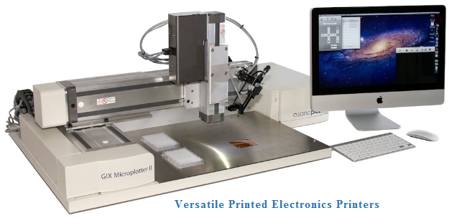

Slide 29
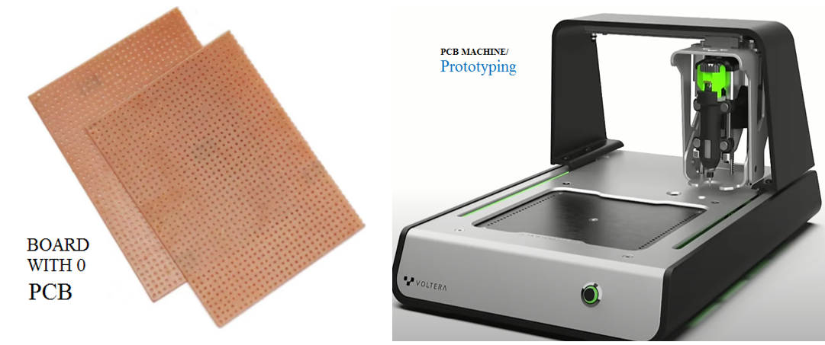

Slide 30
Advantages of In house printing
Greater control and confidentiality
Offer a greater Customization and flexibility
Cost efficiency for small runs.
Understanding the specifics.

Slide 31
Disadvantages of In house printing
Initial investment and maintenance is a challenge.
Limited capacity
Searching for Expertise
Risk of technology obsolescence
Expansion of the staff.
High Price
Competitive risks.

Slide 32
Advantages of Outsourcing Printing
Access to specialized expertise
Save Time
Cost Saving
Reducing Risks
Scalability
Focus on core business

Slide 33
Disadvantages of Outsourcing Printing
Quality control and communication is a challenge.
Dependency and lead times is a challenge also.
Confidentiality concerns on the side of security is a challenge.

Slide 34
2.1.7.PCB documentation
PCB (Printed Circuit Board) documentation refers to the set of documents, drawings, files, and information used in the design, development, fabrication, assembly, and testing of printed circuit boards.
PCB documentation typically includes the following elements:
Schematics: Circuit diagrams that illustrate the electrical connections between components, including their relationships and functionalities. Schematics are the starting point for PCB design
Bill of Materials (BOM): A list of all components required for the PCB assembly.
Gerber Files: These files contain information about the copper traces, pads, and other features on each layer of the PCB.

Slide 35
CAD Files: Computer-Aided Design (CAD) files contain the PCB layout, component placement, and routing information. Software like Altium Designer, Eagle, KiCad, and others generate these files.
Assembly Drawings: Detailing the arrangement of components, their orientations, and any special instructions for assembly. These drawings aid in the correct placement and soldering of components.
Fabrication Drawings: Provide detailed specifications for the PCB's physical characteristics, including dimensions, hole sizes, material types, layer stack-up, and tolerances.
Test Procedures: Instructions for testing and validating the PCB's functionality and performance. This includes guidelines for various testing methods, such as functional testing, electrical testing, and inspection criteria.
Etc.

Slide 36
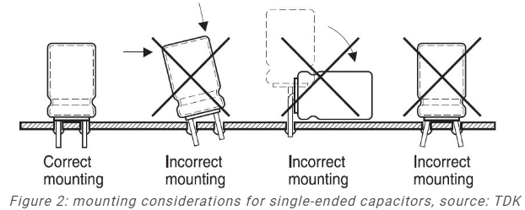
2.2.Mounting components on PCB
Mounting components on a PCB is the process of attaching electronic components to a printed circuit board (PCB).
The PCB provides a platform for the electronic components to be placed, wired, and soldered together.
It is important to ensure that the components are properly mounted and wired to avoid electrical faults and performance issues.

Slide 37
Assemble PCB(PCBA) components
Assembling PCB components involves physically installing the individual parts onto the printed circuit board.
This typically requires a soldering iron to attach wires and components to the PCB.

Slide 38
Test the PCBA
Testing a Printed Circuit Board Assembly (PCBA) is crucial to ensure its functionality and reliability.
To test a PCBA, the first step is to collect the necessary tools, such as a multimeter.
Using the multimeter, you can test the electrical circuits in the PCBA to ensure they are functioning correctly.

Slide 39
1. Short Circuit Testing:
It is a method of testing an electrical flow in the circuit.
This is done by connecting two nodes in the circuit with a very small resistance or zero resistance.
The main purpose of this testing is to detect the faults or weaknesses in the circuit, such as overload protection devices, wiring faults, or grounding issues.
It involves using a multimeter or specialized testing equipment to detect any paths where current flows where it shouldn't.

Slide 40
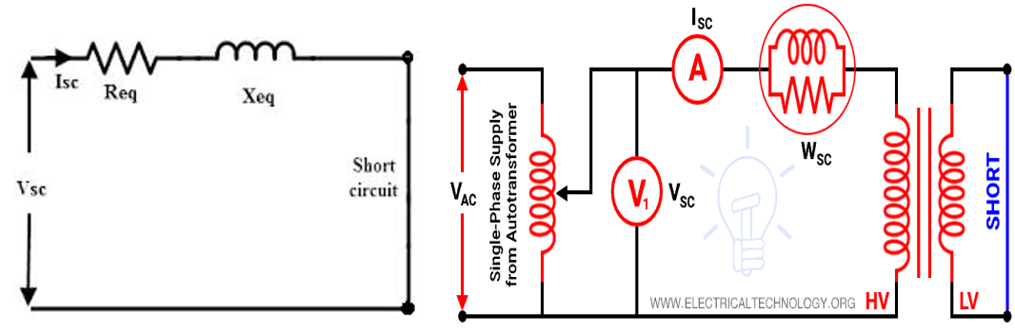

Slide 41
2. Open Circuit Testing
Open circuit testing in PCB refers to the process of verifying that there are no electrical continuity between components or between a component and ground.
This is accomplished by using a multimeter set to the Ohm scale and probing between the components or between a component and ground.
During this process, the meter will indicate whether there is any connection or resistance between the components or between a component and ground.
This type of testing is important to ensure that there are no short circuits, which could cause damage to the circuit or even the components themselves.

Slide 42
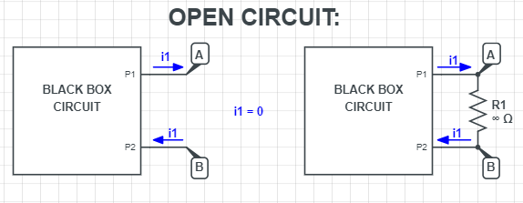

Slide 43
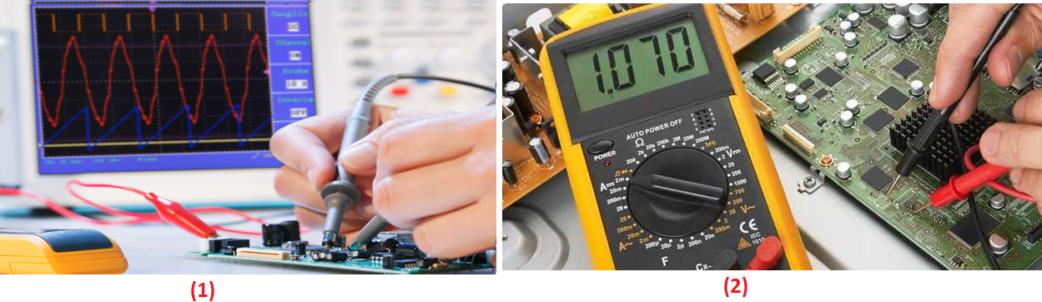
3.Functional Testing
Functional testing in PCB (Printed Circuit Board) is a process of verifying that the PCB design and implementation meet functional requirements and specifications.
Functional testing aims to demonstrate compliance with the system functionality, reliability, and maintainability.

Slide 44
2.3.Testing embedded Hardware
Embedded hardware testing for PCB typically involves the use of specialized test equipment and techniques to verify the proper functioning of various components on a printed circuit board.
Here we include:
Functional testing
Reliability testing

Slide 45
END FOR LO2

